Slide 1


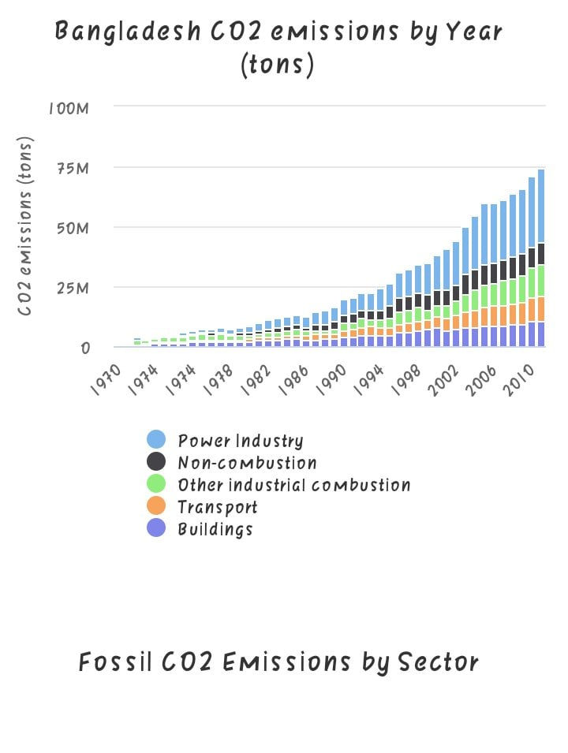





TOPIC NAME :Predicting Carbon Emission of a Particular Area
Participant Name: Arka Chakraborty, Tashdid Abbasy Tonmoy
Department :Electrical & Electronic Engineering
Introduction:
RESULTS & DIUSSIONS
The rate of Carbon emission in our country is increasing day by day. So taking this our most concern we want to predict how the emission rate will be increased in upcoming days. To solve this we have developed a Machine Learning Model . And we will deploy this model in a website. Through this website anyone can predict the rate of Carbon emission in upcoming days in a particular area. We are also working to add real time navigation system of carbon emission of a particular region .
Adding some features we have done the model training. We test it and preliminarily get the model accuracy rate only 87%. To higher the accuracy rate, we will add some more features in the model. We will also use some other algorithms to cross check the model accuracy rate.
Contents
Methodology
Machine Learning – Multivariate Linear
Regression algorithms
2) Making websites –
>Bootstrap
> Django
3) Juypter Notebook
4) Data analysis Tool
>Numpy
>Pandas
>Matplotlib
At first we take data from different sources and clean the data as well as manipulate them.
At the second step we create our own dataset and load the data in the jupyther notebook. The data set looks something like that.
Here x_1, x_2,x_3……… x_n is our features. We use various types of variables as features such as power plants capacity, factories amount, vehicles numbers , deforestaiton rate, population growth etc . Y is our label data(Amount of carbon emission).
3)Now we have the dataset and we plot them.Here one of our feature is Year. First we plot the other features against year and also the label data against year.
4) When we compare the two plots. We can see
there is a linear relationship between year and
the other features and also between the year
and the label data. Now we use Multivariate
linear regression with Gradient algorithm to
predict the carbon emission.
5)Here is a short description about multivariate linear regression
> First the model make a hypothesis. Here, (y=m_0*x_0+m_1*x_1+……… + m_n*x_n, It is mainly a straight line. And by this line we predict the Y value)
>Now this line will try to fit in the data . So it will optimize the value of m_0,m_1…….m_n. This will ultimately reduce the cost function. The cost function of the Linear regression is
(1/2n)$\sum_{i=1}^{n}{({y_{prediction}}^{\left(i\right)}−y^{\left(i\right)})^2}$
>When the model minimize the cost function, then the line will be the best fit line and using the hypothesis our model can predict value.
6) Then we deploy our model in our website .
X_1 | X_2 | - | - | - | X_n | Y
1 | 2 | - | - | - | n | 1
References
https://www.worldometers.info/co2-emissions/bangladesh-co2-emissions/
http://www.bpc.gov.bd/
https://www.ceicdata.com/en/indicator/bangladesh/motor-vehicles-sales
https://www.climatelinks.org/resources/greenhouse-gas-emissions-factsheet-bangladesh
https://www.statista.com/statistics/987697/bangladesh-number-garment-factories/
Solving large scale linear prediction problems using stochastic gradient descent algorithms (Author- Tong Zhang)
https://www.kaggle.com/residentmario/gradient-descent-with-linear-regression
https://www.kaggle.com/residentmario/gradient-descent-with-linear-regression
https://youtu.be/sM1xFEZ7-q0

